Slide 1
CS4283/5283: Computer Networks
Dr. Uttam Ghosh
Computer Science
Vanderbilt University
uttam.ghosh@vanderbilt.edu

Slide 2
Team
Instructor:
Uttam Ghosh : uttam.ghosh@vanderbilt.edu
Department of EECS, FGH, Room 381
Homepage: https://engineering.vanderbilt.edu/bio/uttam-ghosh
Class Hours: TR 11:00a-12:15p, FGH 138
Office Hours: F: 12:00p-4:00p (by appointment)
TA’S:
Ziran Min, ziran.min@vanderbilt.edu
orig12.deviantart.net

Slide 3
About Myself
Education
B.Tech in IT, WBUT, India.
MS and PhD in E&ECE, IIT Kharagpur, India.
Experience
Worked as Postdoctoral Research Fellow, ADSC Singapore (University of Illinois Urbana-Champaign).
Worked as Postdoctoral Teaching Fellow, Fordham University, NY, USA.
Worked as Postdoctoral Research Associate, TSU, TN, USA.
Worked as Instructor TSU, TN, USA.
orig12.deviantart.net

Slide 4


Textbook
Behrouz Forouzan: Data Communications and Networking, 4th Edition
Kurose & Ross: Computer Networking: A Top-Down Approach, 7th Edition

Slide 5



Course Management
All course information will be on Brightspace
https://www.vanderbilt.edu/brightspace/
All lectures will be posted on Top Hat
https://app.tophat.com/
Sign up to CS 3281 for Piazza
http://www.piazza.com
  You will receive an e-mail invitation
  Ask and answer questions
  Follow specified rules (no sharing of code)
go.boisestate.edu
ucbstartupfair.com

Slide 6
Course Content (*Subject to Change)
Lectures
In-class exercises
Quizzes (4 total)
  All scores will be included
Homeworks (4 total)
  All scores will be included
Mid Term Exam- No mid-term!
*Comprehensive Final Exam/Project/Research Paper

Slide 7
Grading (*Subject to Change)
Component | Weight
Homework – about 4 | 40%
Class quizzes – about 4 | 35%
Class participation | 5%
Midterm | No mid-term!
*Final Exam/Project/Research Paper | 20%

Slide 8
Honor Code
The Vanderbilt Honor Code governs all work in this course
If you have questions ask your instructor or visit the Honor Council website at
http://studentorgs.vanderbilt.edu/HonorCouncil/

Slide 9
Course Goals
Computer Communications and Networking Fundamentals.
The TCP/IP and OSI (Open System Interconnection) reference models for communication and networking.
Types of Communication Networks
Wireless Networks
Network Security
Special Topics: Software-defined networking (SDN) and Information Centric Networking (ICN)
Network Simulator/Mininet Emulator/Wireshark
orig12.deviantart.net

Slide 10
Data Communications
The term telecommunication means communication at a distance.
Data refers to information presented in whatever form is agreed upon by the parties creating and using the data.
Data communications are the exchange of data between two devices via some form of transmission medium such as a wire cable.

Slide 11
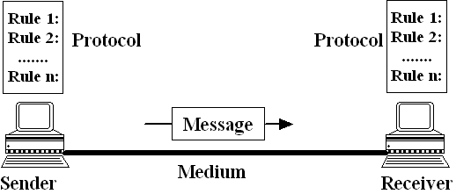
Data Communication Components
Protocol is a set of rules (syntax, semantics and timing) that governs communications between devices.

Slide 12
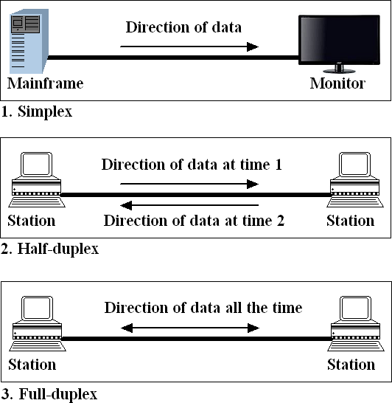
Data Flow: Simplex, Half-duplex and Full-duplex

Slide 13
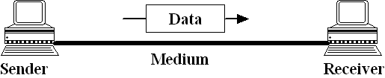
Network
A network is a set of devices (nodes) connected by communication links.
A node can be a computer, printer, or any other device capable of sending and/or receiving data generated by other nodes on the network.
A network consisting of two nodes

Slide 14
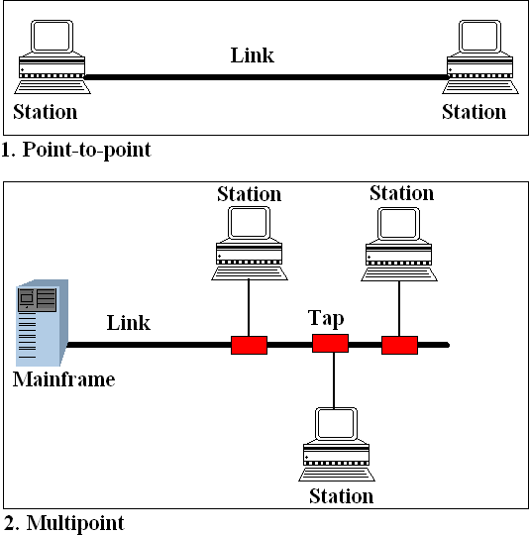
Types of Connections: Point-to-point and Multipoint

Slide 15
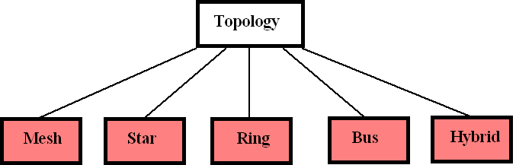
Categories of Topology

Slide 16
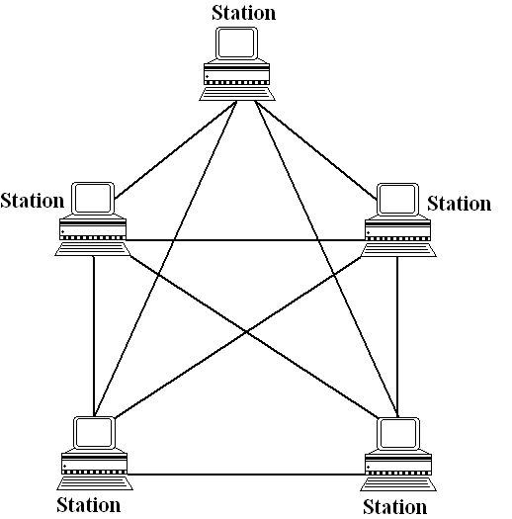
Mesh Topology
Advantages:
Each connections can carry its own data.
Robust and Secure
Easy fault identification and fault isolation
Disadvantages:
Amount of cabling (and also cost) and IO ports.

Slide 17
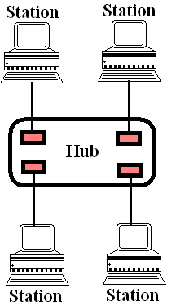
Star Topology
Advantages:
Less expensive than Mesh.
Robust
Easy fault identification and fault isolation
Disadvantages:
If Hub fails, whole network fails.
More cabling than ring/bus.

Slide 18
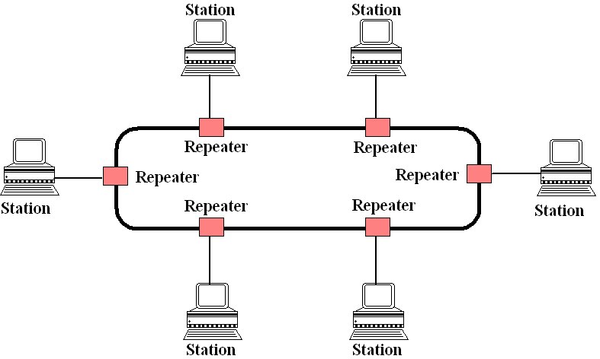
Ring Topology
Advantages:
Less cabling than Mesh and Star.
Point-to-point
Disadvantages:
Fault or break in ring stops all transmission.

Slide 19
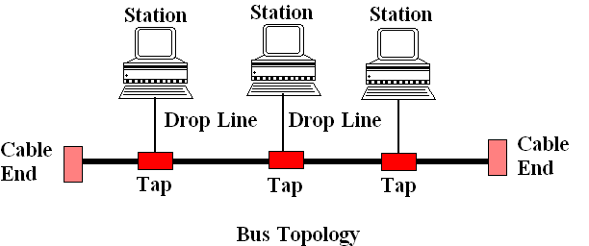
Bus Topology
Advantages:
Less cabling than Mesh and Star.
Multipoint
Disadvantages:
Fault or break in bus stops all transmission.
Difficult fault identification and fault isolation

Slide 20
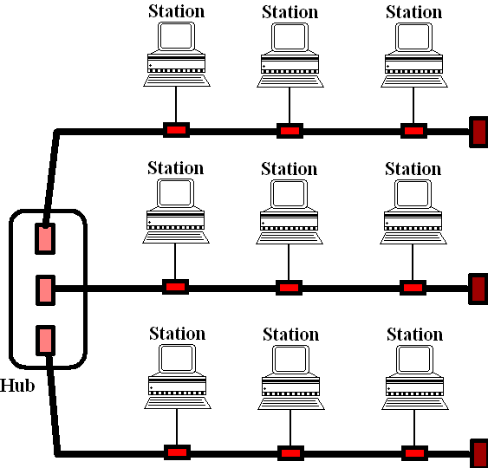
Hybrid Topology

Slide 21
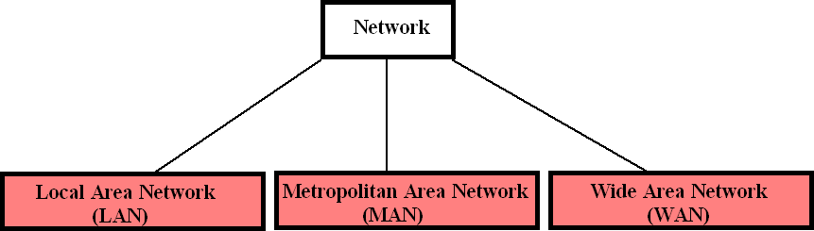
Categories of Networks
LAN: Privately owned and links devices in a single building, office or campus.
MAN: Designed to extend over entire city.
WAN: Provides long-distance transmission over a large geographic areas (country, whole world).
internet: More than one network connected.
Internet: A collaboration of more than hundreds of thousands interconnected networks.

Slide 22
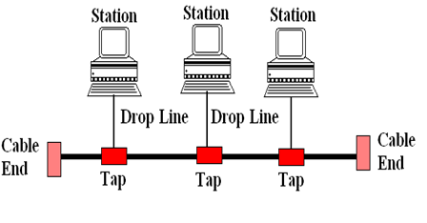
Local Area Network (LAN)
LAN 1
LAN 2
LAN 3

Slide 23
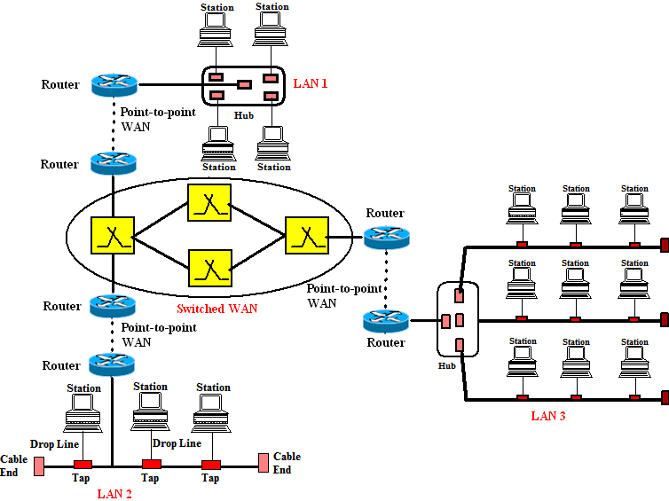
Wide Area Network (WAN)

Slide 24
Network Models

Slide 25
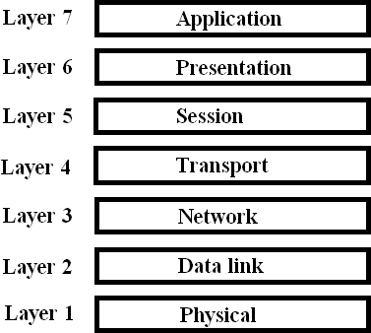
Seven Layers of the Open Systems Interconnections (OSI) Model

Slide 26
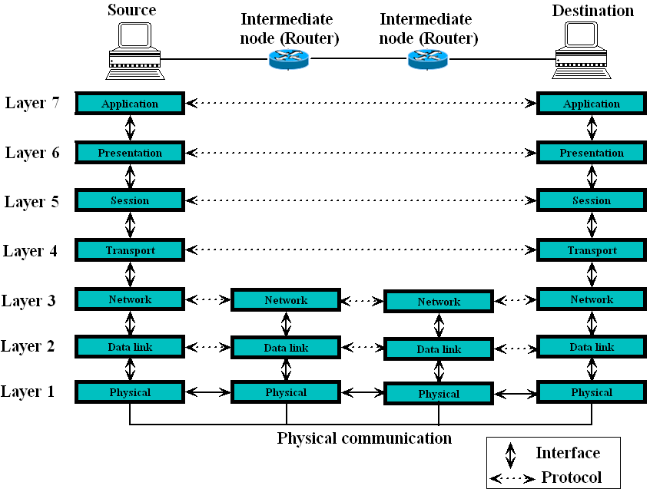
Interaction between layers in OSI Model

Slide 27
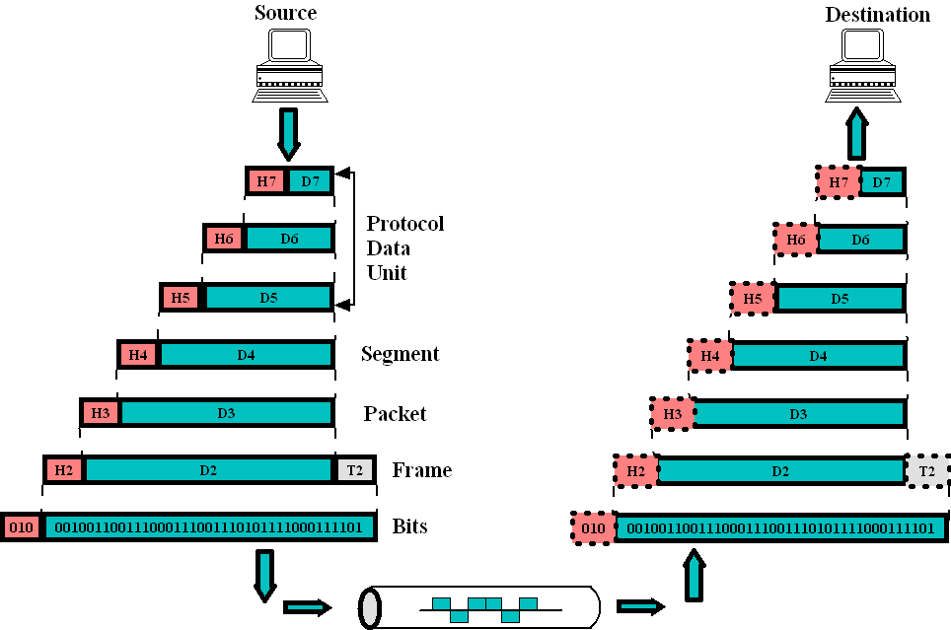
Data Exchange using OSI Model

Slide 28
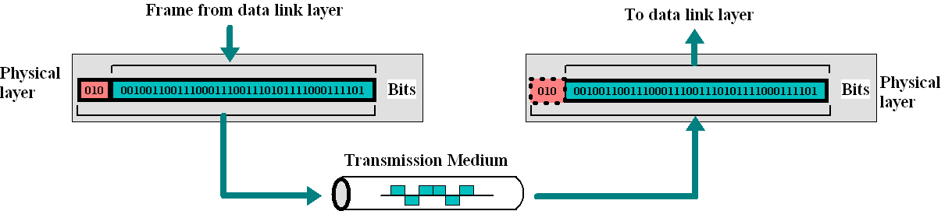
Physical layer
Responsible for movement of individual bits from one hop to next hop
Physical characteristics of the medium
Representation of bits, i.e. encoding
Data Rate/Transmission Rate ( number of bits/sec)
Synchronization of bits– by synchronization of sender and receiver clocks
Physical Topology
Transmission Mode (simplex/full-duplex/half-duplex)

Slide 29
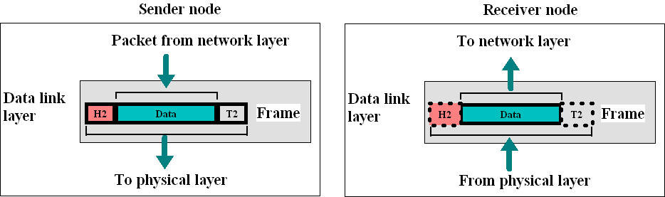
Data link layer
Responsible for frames from one hop to next hop (node)
Framing- Dividing the stream of bits from network layer into frames.
Physical Addressing –Adding headers to a frame to define sender and/or receiver.
Flow Control – To prevent overflow of the receiving mechanism of receiver.
Error Control (Encapsulation)– Detecting and retransmitting lost frames by adding a tail.
Access Control – To determine control over link.

Slide 30
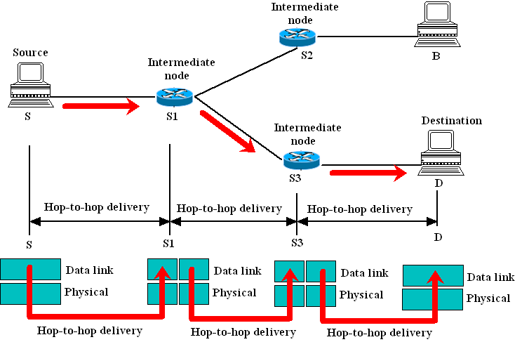
Data link layer: Hop-to-hop delivery

Slide 31
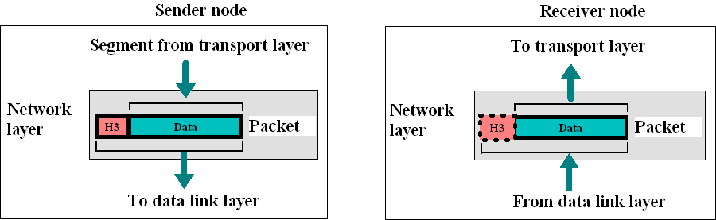
Network layer
Responsible for delivery of individual packets from source node to destination node
Logical Addressing –It adds a header that include logical address of source and destination.
Routing – computes the shortest path to delivery packets to their final destination from a source.

Slide 32
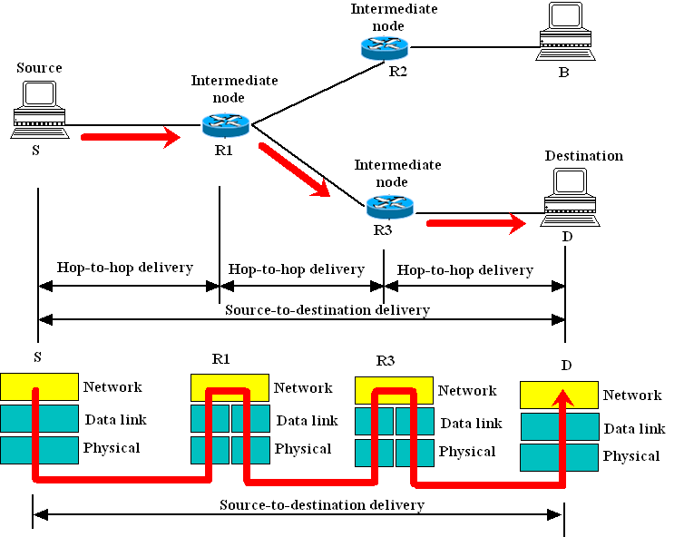
Network layer: Source-to-destination delivery

Slide 33
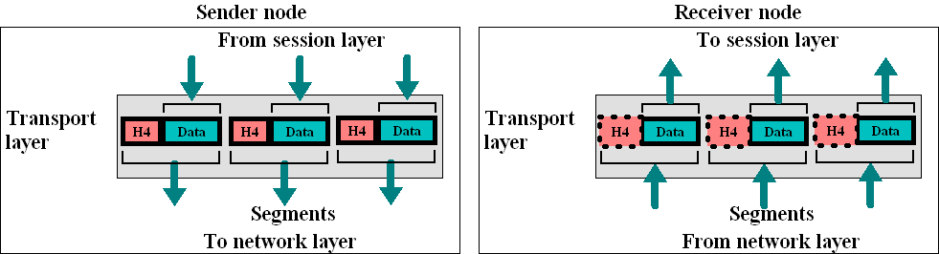
Transport layer
Responsible for delivery of messages from one process to another
Port addressing- to identify each process uniquely
Segmentation and reassembly of the divided message, in form of transmittable segments, each with a unique sequence number.
Connection Control – Connectionless or Connection-Oriented
Flow Control performed end-to-end.
Error Control performed process-to-process.

Slide 34
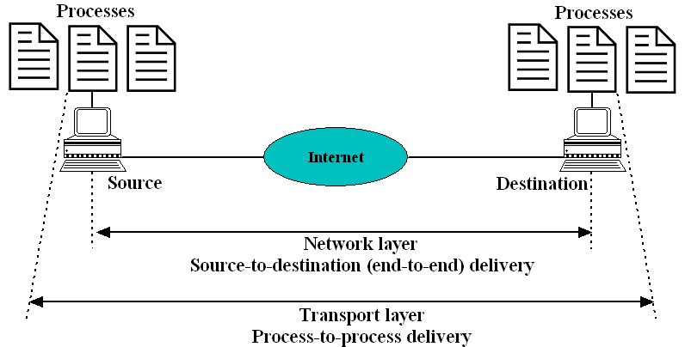
Transport layer: Process-to-process delivery

Slide 35

Session layer
Responsible for dialog control and synchronization
Dialog Control by allowing communication between two processes to take place in either half-duplex mode or full-duplex mode.
Synchronization by utilization of synchronization checkpoints.

Slide 36
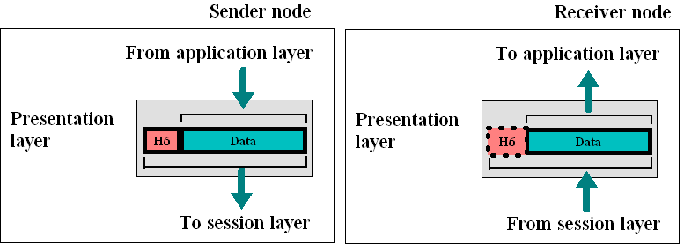
Presentation layer
Responsible for translation, compression and encryption

Slide 37
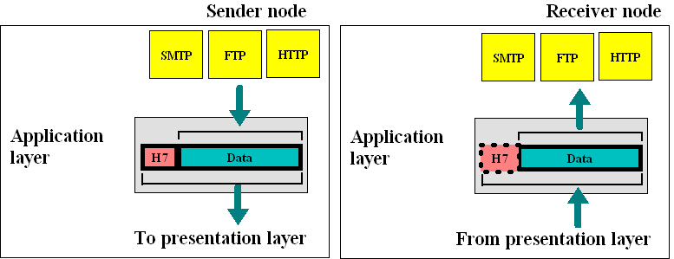
Application layer
Responsible for providing services to the user
File Transfer- FTP
Mail Transfer- SMTP
Directory Services- for accessing global information about objects and services using HTTP/HTTPS

Slide 38
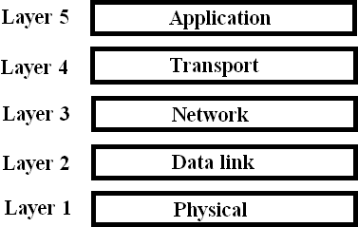
TCP/IP Model

Slide 39
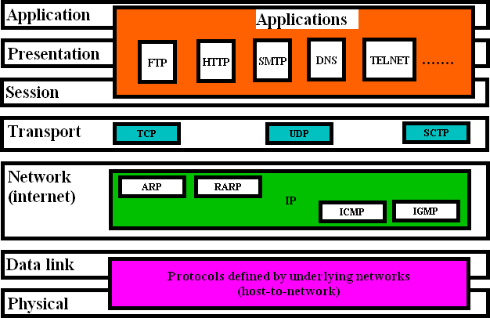
TCP/IP Model and OSI Model

Slide 40
Functionalities in OSI Protocol Stack: Summary
  To allow access to network resources
  To translate, encrypt, and compress data
  To establish, manage, and terminate sessions
  To provide reliable process-to-process message delivery and error recovery
  To move packets from source to destination and provide logical addressing
  To organize bits into frames; to provide hop-to-hop delivery
  To transmit bits over a medium; synchronize between sender and receiver

Slide 41
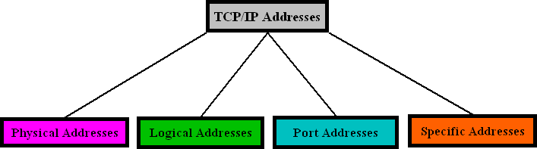
Addressing
Four levels of addresses are used in an internet employing the TCP/IP protocols: physical, logical, port, and specific.

Slide 42
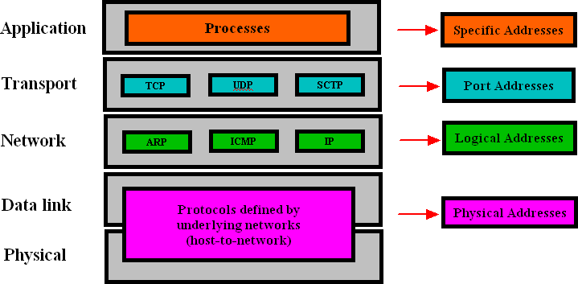
Relationship of layers and addresses in TCP/IP

Slide 43
Physical (MAC) Address
Local-area networks use a 48-bit (6-byte) physical address written as 12 hexadecimal digits; every byte (2 hexadecimal digits) is separated by a colon, as shown below:
07:01:02:01:2C:4B
A 6-byte (12 hexadecimal digits) physical address.

Slide 44
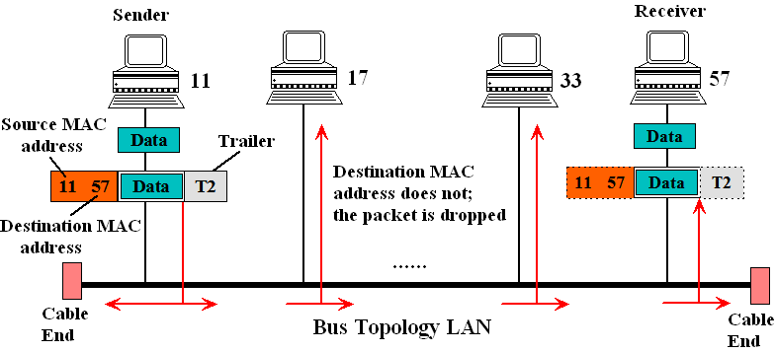
Physical (MAC) Address: Example
In the following Figure, a node with physical address 11 sends a frame to a node with physical address 57. The two nodes are connected by a link (bus topology LAN). As the figure shows, the computer with physical address 11 is the sender, and the computer with physical address 57 is the receiver.

Slide 45
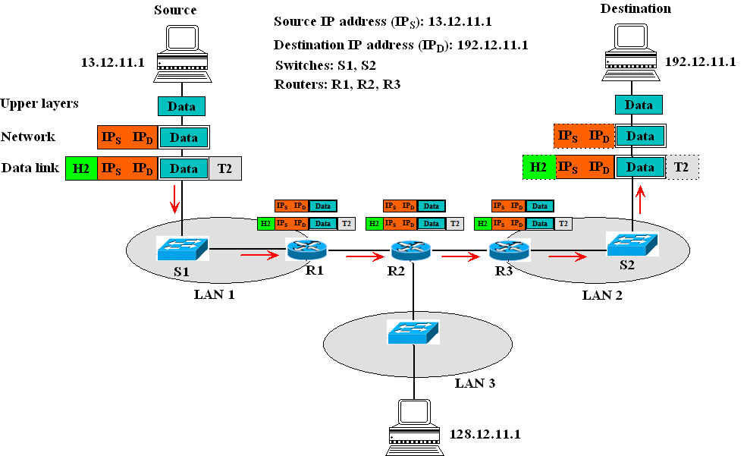
Logical (IP) Address: Example

Slide 46
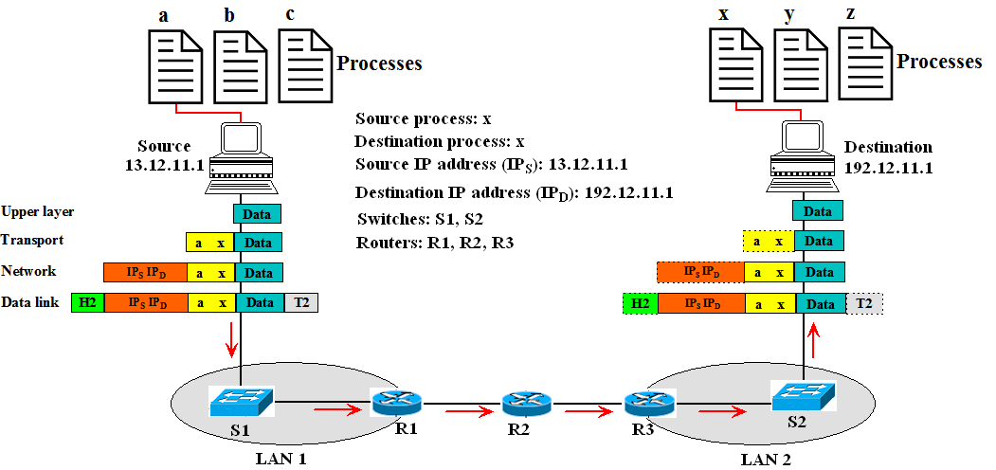
Port Addresses
Figure shows two computers communicating. The sending computer is running three processes at this time with port addresses a, b, and c. The receiving computer is also running three processes at this time with port addresses x, y and j. Process a in the sending computer needs to communicate with process x in the receiving computer. Note that although physical addresses change from hop to hop, logical and port addresses remain the same from the source to destination.

Slide 47
Virtual LAN (VLAN)
We can roughly define a virtual local area network (VLAN) as a local area network configured by software, not by physical wiring.

Slide 48
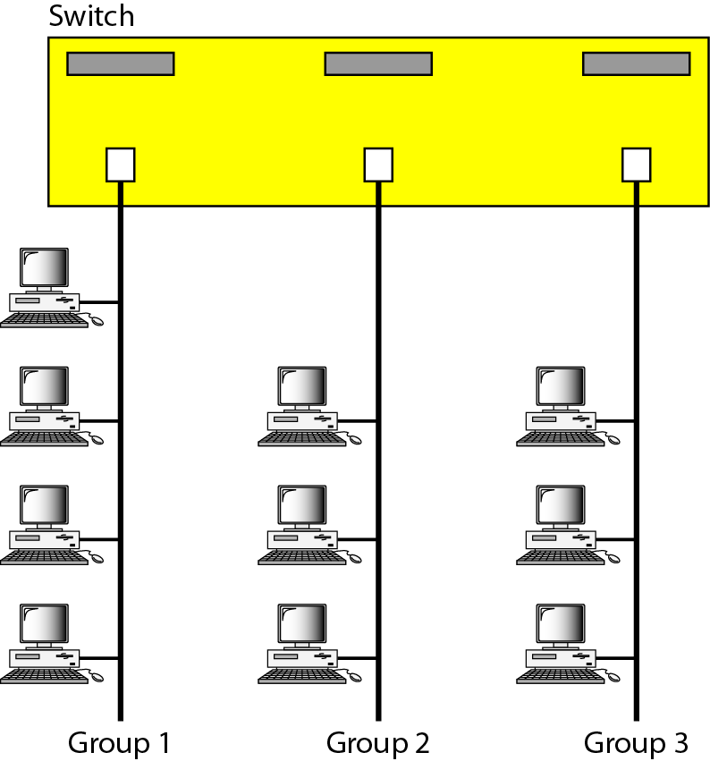
A Switch Connecting 3 LANs

Slide 49

A Switch using VLAN software

Slide 50

Two Switches in a backbone using VLAN software

Slide 51



